Slide 1

CSCI/ARTI 8950 Machine Learning
Lecture Notes 12: Neural Networks
Khaled Rasheed
Professor
School of Computing
Member
Institute for Artificial Intelligence
University of Georgia
Credit: some examples & figures by Marine Carpuat, Tom Mitchell and Hal Daumé III

Slide 2
Neural Networks
Topics
What are Neural Networks?
How to make a prediction given an input?
Why are neural networks powerful?
how to train them?

Slide 3
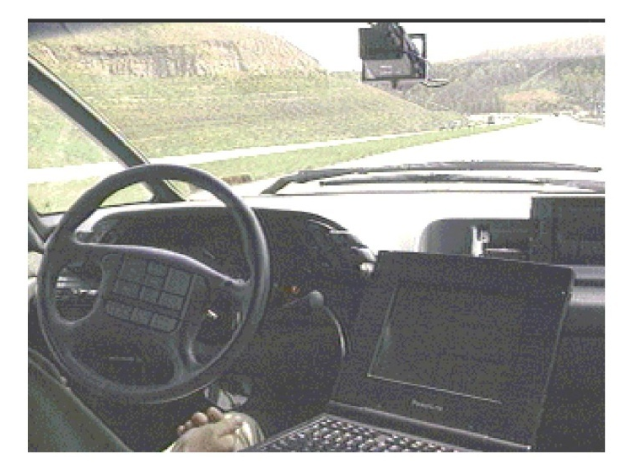
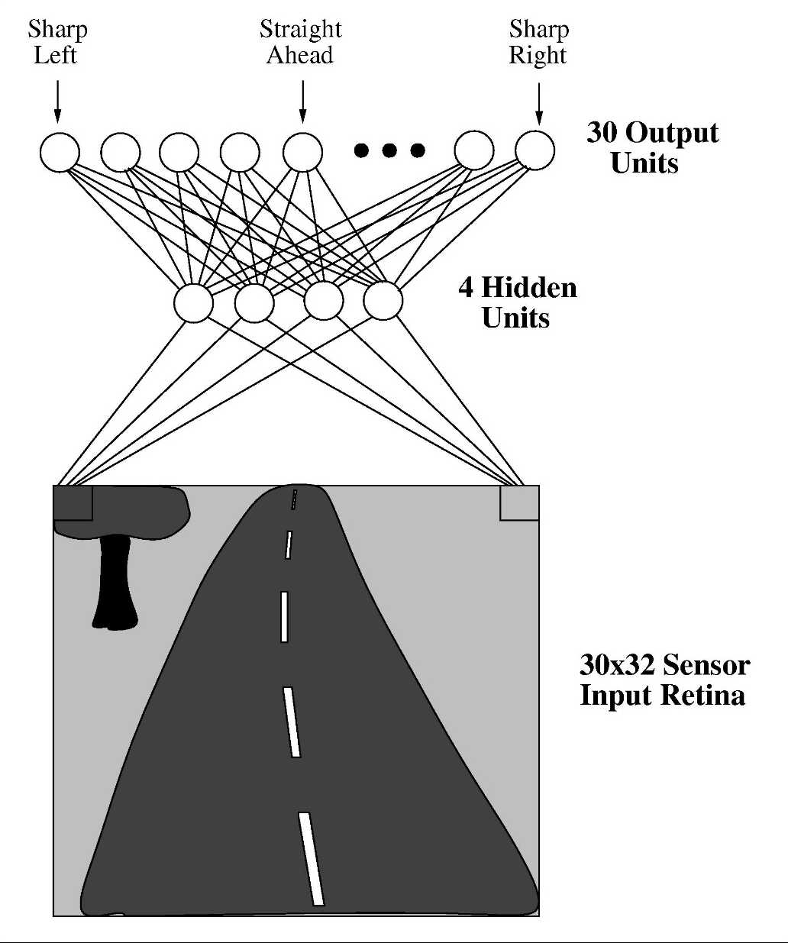
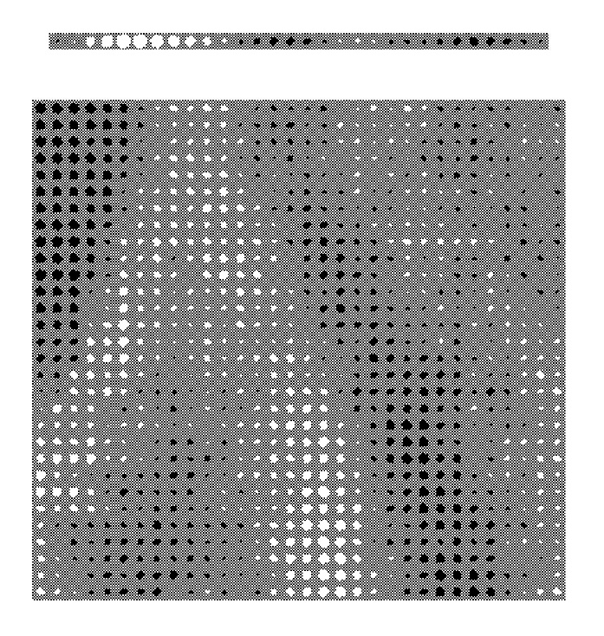
Neural network example (1989)

Slide 4
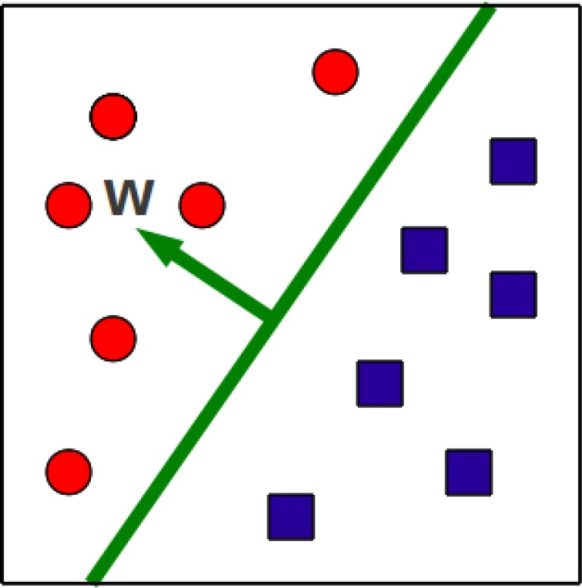
Binary classification via hyperplanes
At test time, we check on what side of the hyperplane examples fall
𝑦 = 𝑠𝑖𝑔𝑛(𝑤^{𝑇}𝑥 + 𝑏)

Slide 5
Function Approximation with Perceptron
Problem setting
Set of possible instances 𝑋
Each instance 𝑥 ∈ 𝑋 is a feature vector 𝑥 = [𝑥₁, … , 𝑥_{𝐷}]
Unknown target function 𝑓: 𝑋 → 𝑌
𝑌 is binary valued {-1; +1}
Set of function hypotheses 𝐻 = ℎ ℎ: 𝑋 → 𝑌}
Each hypothesis ℎ is a hyperplane in D-dimensional space
Input
Training examples { 𝑥 ¹ , 𝑦 ¹
target function 𝑓
Output
, … 𝑥 ^{𝑁} , 𝑦 ^{𝑁} } of unknown
Hypothesis ℎ ∈ 𝐻 that best approximates target function 𝑓

Slide 6
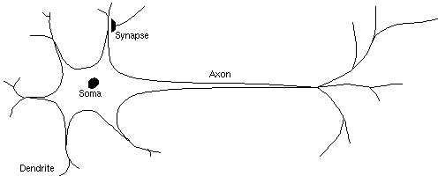
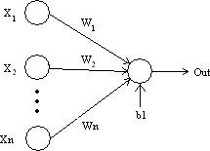
Aside: biological inspiration
Analogy: the perceptron as a neuron

Slide 7
Neural Networks
We can think of neural networks as combination of multiple perceptrons
Multilayer perceptron
Why would we want to do that?
Discover more complex decision boundaries
Learn combinations of features

Slide 8
Example of a 2-layer perceptron
Key concepts:
Input dimensionality
Hidden units
Hidden layer
Output layer
Activation functions

Slide 9
Activation functions (aka link or transfer functions)
Activation functions are non-linear
functions
sign function as in the perceptron
hyperbolic tangent and other sigmoid functions that approximate sign but are differentiable

Slide 10
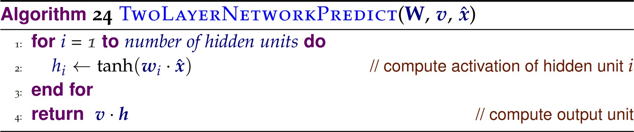
Vector of output layer parameters
Matrix of hidden layer parameters

Slide 11
What functions can we approximate with a 2 layer perceptron?
Problem setting
Set of possible instances 𝑋
Each instance 𝑥 ∈ 𝑋 is a feature vector 𝑥 = [𝑥₁, … , 𝑥_{𝐷}]
Unknown target function 𝑓: 𝑋 → 𝑌
𝑌 is binary valued {-1; +1}
Set of function hypotheses 𝐻 = ℎ ℎ: 𝑋 → 𝑌}
Input
Training examples { 𝑥 ¹ , 𝑦 ¹
target function 𝑓
Output
, … 𝑥 ^{𝑁} , 𝑦 ^{𝑁} } of unknown
Hypothesis ℎ ∈ 𝐻 that best approximates target function 𝑓

Slide 12

Two-Layer Networks are Universal Function Approximators
Theorem (Th 9 in CIML):
Let F be a continuous function on a bounded subset of D- dimensional space. Then there exists a two-layer neural network 𝐹 with a finite number of hidden units that approximates F arbitrarily well. Namely, for all x in the domain of F,

Slide 13


Example: a neural network to solve the XOR problem
φ₀(x₁) = {-1, 1} φ₀(x₂) = {1, 1}
φ₁(x₃) = {-1, 1}
O
φ
φ₁[1]
X O
2
φ₁
φ₁[0]
O
X
X
φ₁(x₁) = {-1, -1}
O
φ₁(x₂) = {1, -1}
φ (x ) = {-1, -1} φ (x ) = {1,-1}
3 4
0 0
φ (x ) = {-1, -1}
1
4
1
1
-1
φ₁[0]
-1
-1
-1
φ₁[1]

Slide 14

Example
In new space, the examples are linearly separable!
φ₀(x₁) = {-1, 1} φ₀(x₂) = {1, 1}
φ₀[1]
X O
φ₀[0]
1
1
1
φ₂[0] = y
O X
φ₀(x₃) = {-1, -1} φ₀(x₄) = {1, -1}
φ₁[1]
1
1
-1
φ₁(x₃) = {-1, 1} O
φ₁[0]
φ₁[0]
-1
-1
-1
φ₁[1]
φ₁(x₁) = {-1, -1} _{X}
φ₁(x₄) = {-1, -1}
O
φ (x ) = {1, -1}
1
2

Slide 15
Example
The final net
φ₀[0]
φ₀[1]
1
1
1
tanh
φ₁[0]
1
-1
-1
-1
tanh
φ₀[0]
φ₂[0]
1
tanh
φ [1]
φ [1]
0
1
1
-1
1
1

Slide 16
Discussion
2-layer perceptron lets us
Discover more complex decision boundaries than perceptron
Learn combinations of features that are useful for classification
Key design question
How many hidden units?
More hidden units yield more complex functions
Fewer hidden units requires fewer examples to train

Slide 17
Training Neural Networks

Slide 18
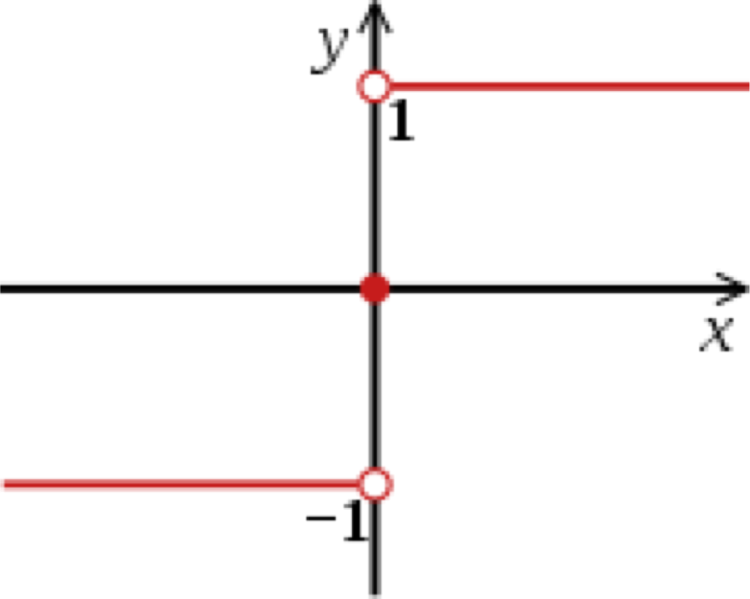
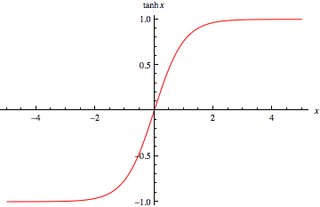
Activation Functions
Examples:
[Source: Furong Huang, UMD]

Slide 19
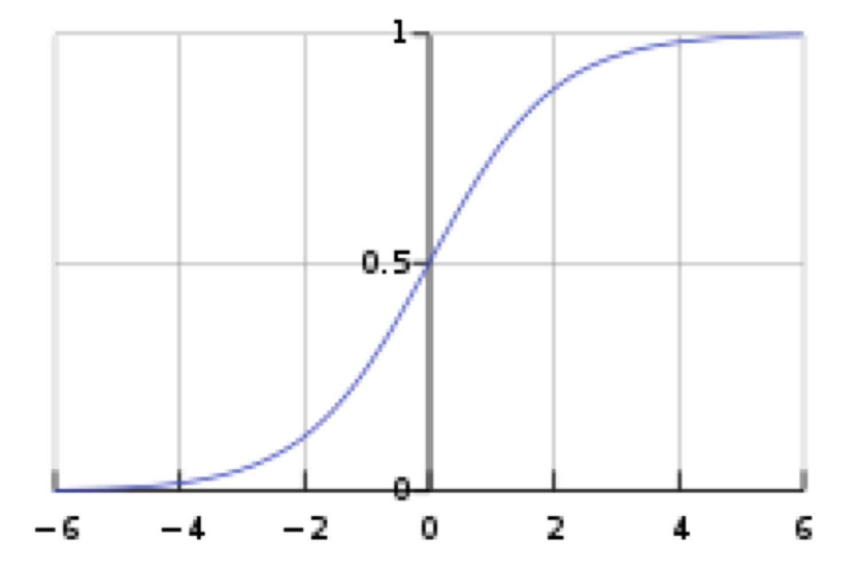
Activation Functions
[Source: Furong Huang, UMD]

Slide 20
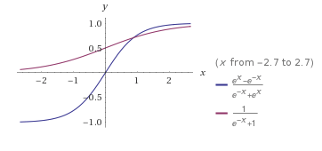
Sigmoid and Tanh comparison
Sigmoid
Tanh
[Source: https://sebastianraschka.com/faq/docs/tanh-sigmoid-relationship.html]

Slide 21
Forward Propagation:
given input x, compute network output

Slide 22
Neural Network Training
Backpropagation algorithm
=
Gradient descent + Chain rule

Slide 23
What’s our Training Objective?
We’ll consider the following objective
– i.e. our goal is to find parameters W, v that minimize squared error
Other objectives are possible (e.g., other loss functions, add regularizer)

Slide 24
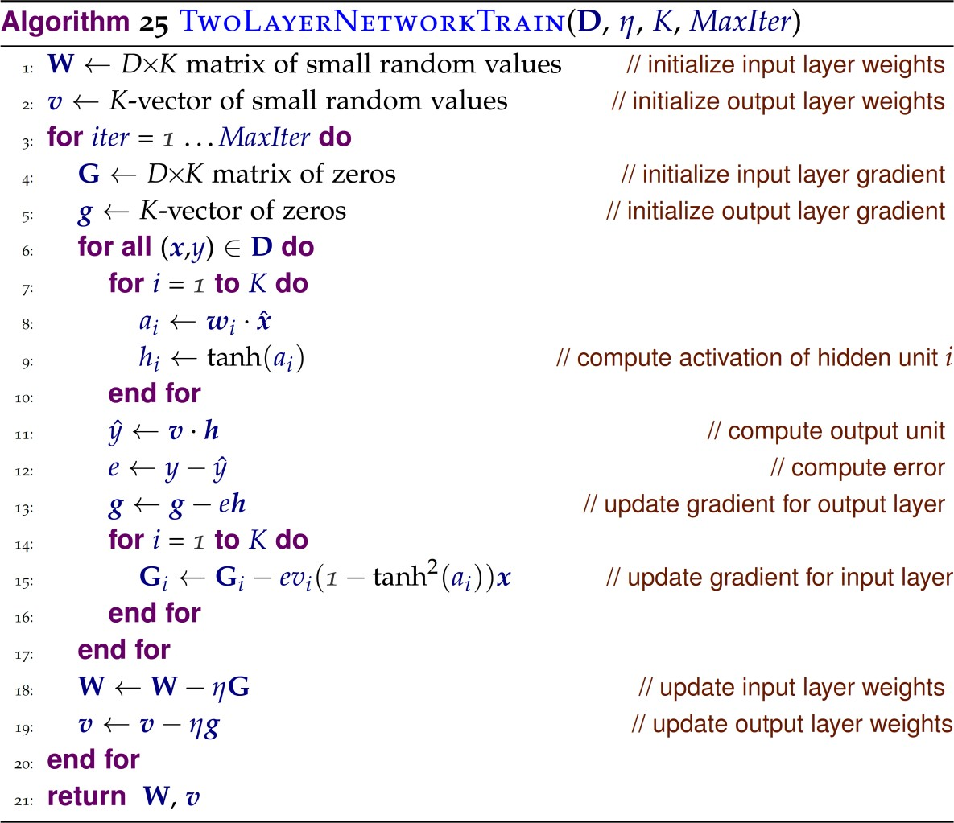
Backprop in a 2-layer network
Compute Gradient G and g

Slide 25
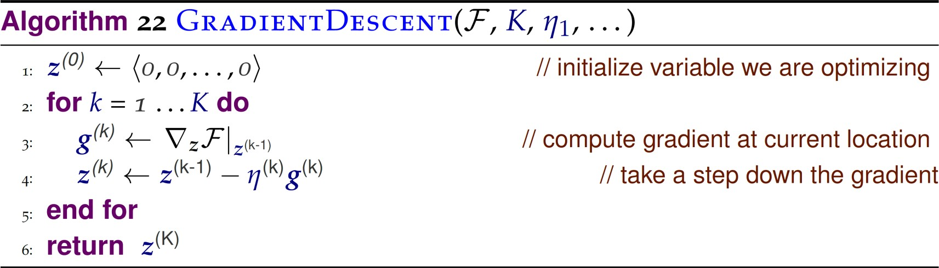
Recall: gradient descent for linear classifiers
Objective function
Number of steps
to minimize
Step size

Slide 26
What’s our Training Objective?
We’ll consider the following objective
– i.e. our goal is to find parameters W, v that minimize squared error
Other objectives are possible (e.g., other loss functions, add regularizer)

Slide 27
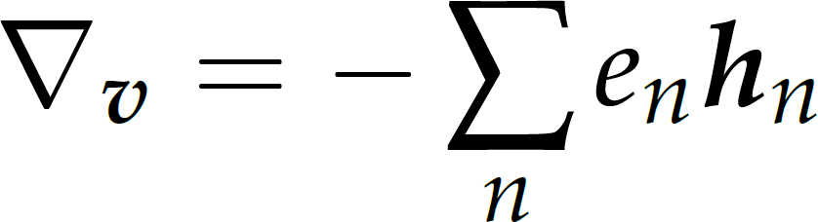
Gradient of objective
w.r.t. output layer weights v
Vector of activations of hidden units for example n
Error at example n:
𝑦_{𝑛} − 𝑦 _{𝑛}
^

Slide 28
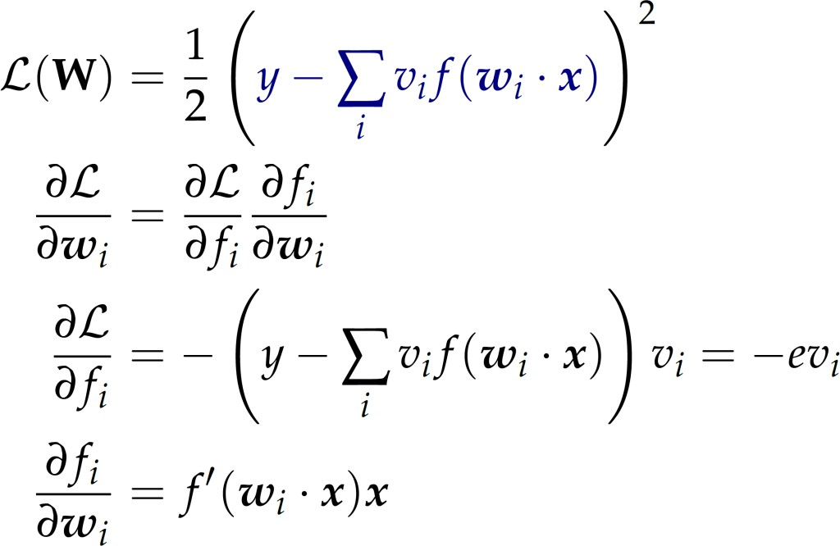

Gradient of objective
w.r.t. hidden unit weights 𝑤_{𝑖}
Chain rule
(This is on one example only)

Slide 29
Backprop in a 2-layer network
Forward propagation
Update gradients
Update parameters

Slide 30
Tricky issues with neural network training
Sensitive to initialization
Objective is non-convex, many local optima
In practice: start with small random values rather than zeros
Many other hyperparameters
Number of hidden units (and potentially hidden layers)
Gradient descent learning rate
Stopping criterion

Slide 31
Neural networks vs. linear classifiers
Advantages of Neural Networks:
More expressive
Less feature engineering
Inconvenients of Neural Networks:
Harder to train
Harder to interpret

Slide 32
Neural Network Architectures
We focused on a 2-layer feedforward
network
Other architectures are possible
More than 2 layers (aka deep learning)
Recurrent network (i.e. network has cycles)
Can still be trained with backpropagation
But more issues arise when networks get more complex (e.g., vanishing gradients)

Slide 33
What you should know
What are Neural Networks?
Multilayer perceptron
How to make a prediction given an input?
Forward propagation: Simple matrix operations + non-linearities
Why are neural networks powerful?
Universal function approximators!
How to train neural networks?
The backpropagation algorithm

